Slide 1
UK HOUSING MARKET
David, Seerat, Hamza, Sarah

Slide 2
INTRODUCTION
We investigated property trends and if market conditions effect the property market. We analysed the average prices of different property types and the sales volumes of new builds vs existing properties. Also, we examined the inflation and interest rates since 2007.

Slide 3





CONTENTS
Introduction
Property Types
New Builds vs Existing Properties
Cash Purchases vs Mortgages
Market Observations
Overall

Slide 4

Property Types
Semi-Detached
Detached
Flat
Terraced

Slide 5
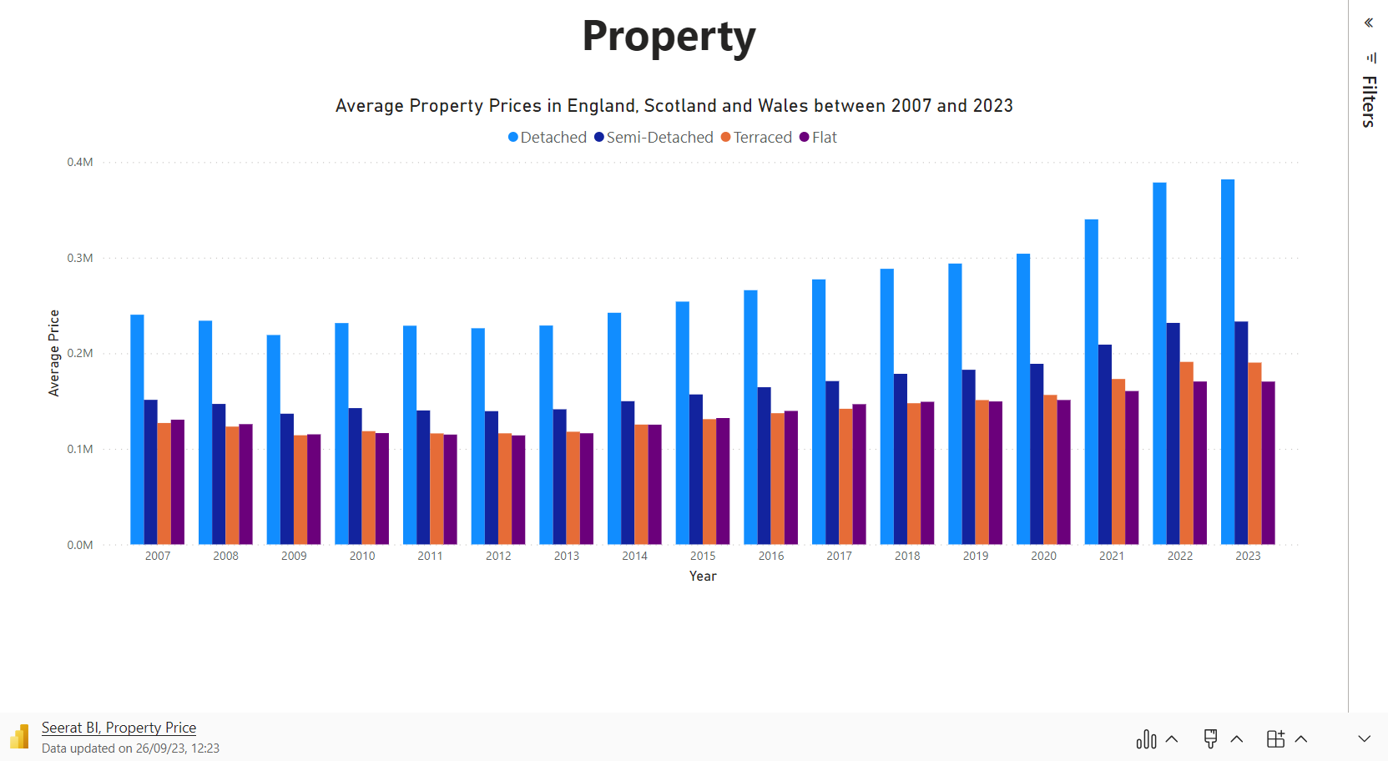

Slide 6
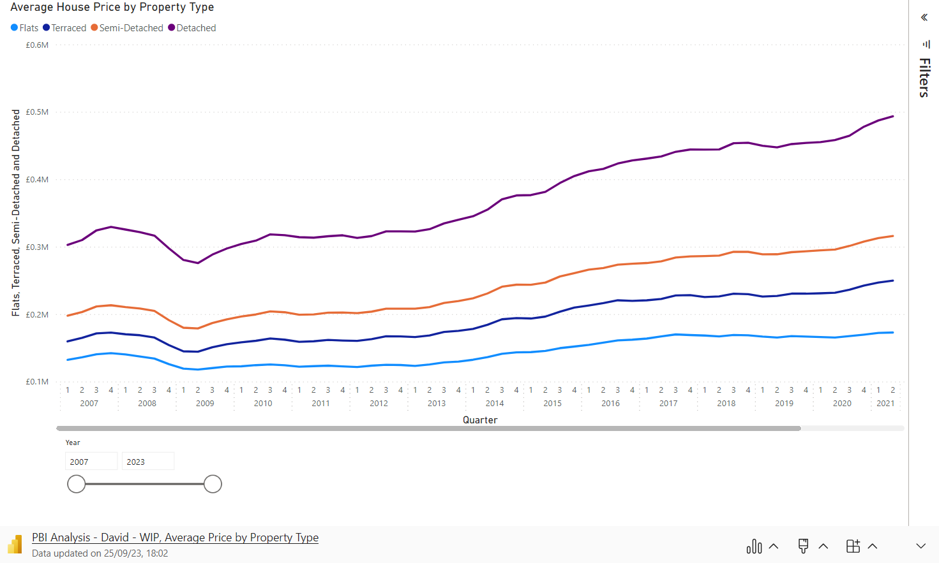

Slide 7
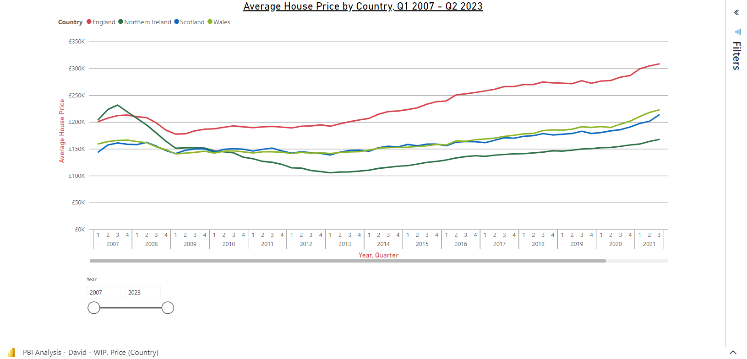

Slide 8
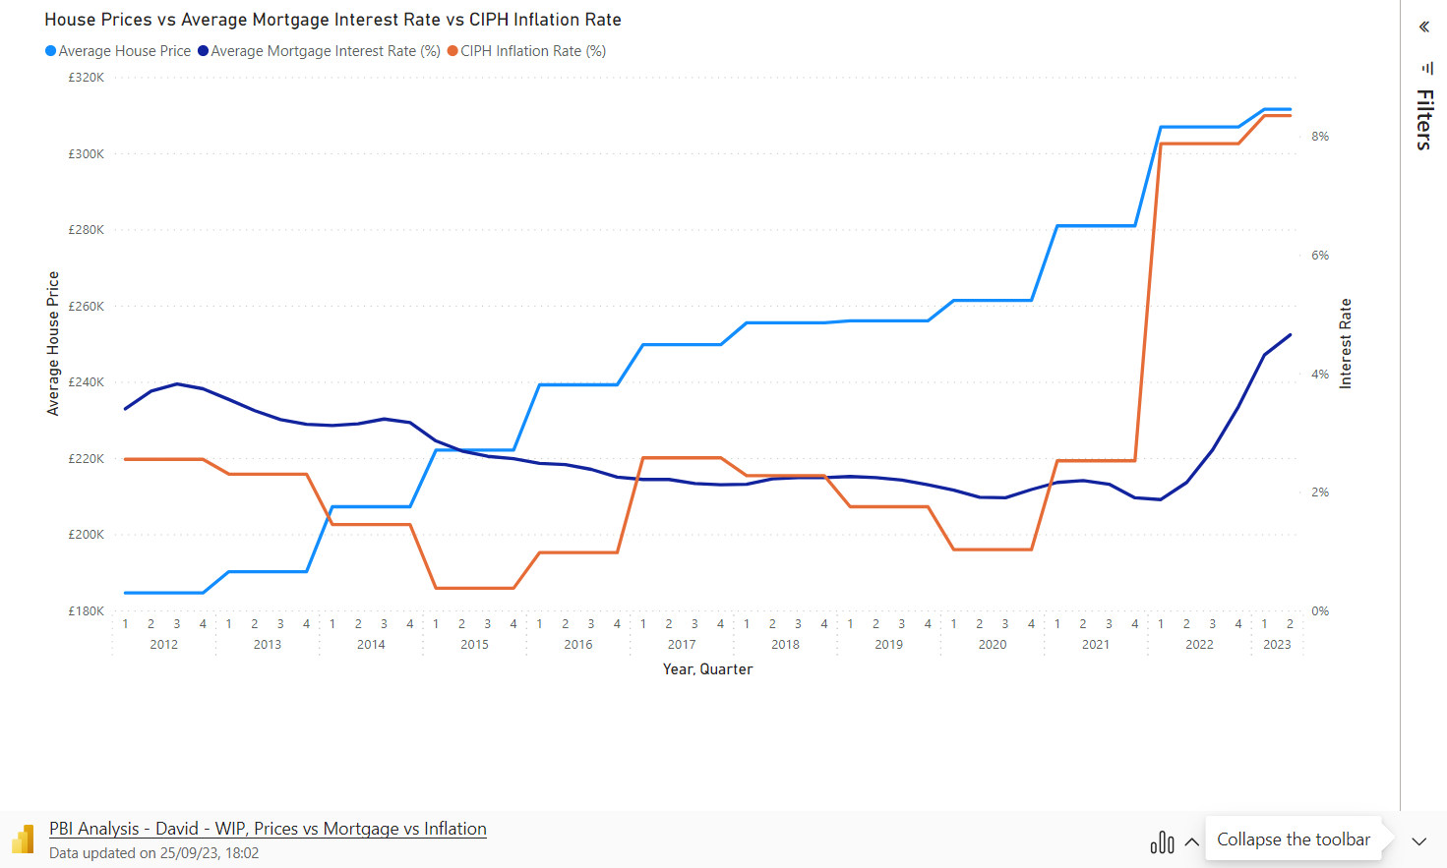

Slide 9
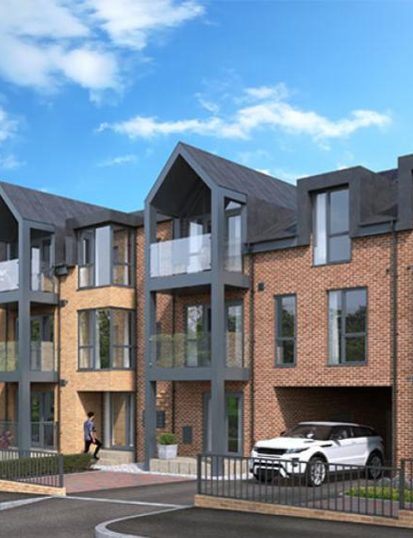
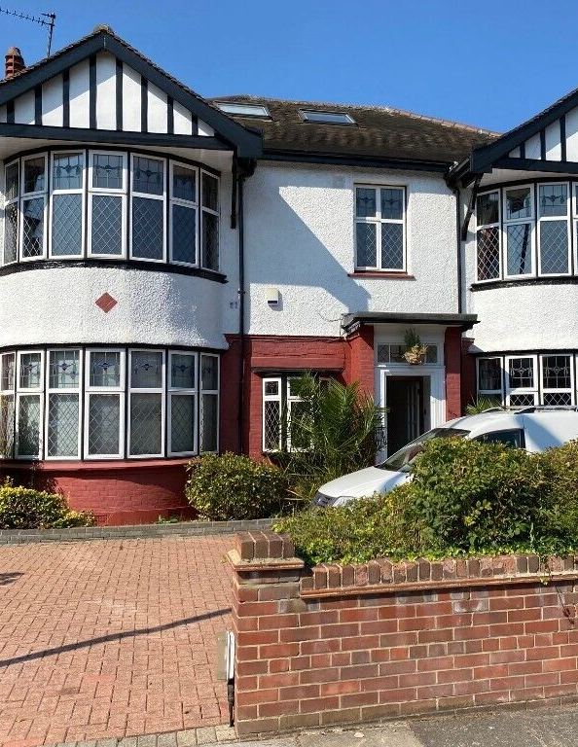

NEW BUILDS VS EXISTING PROPERTIES

Slide 10
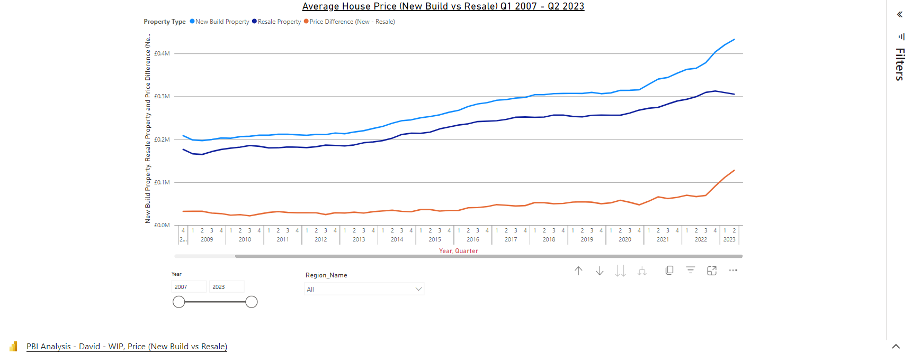
Observations
Based on all regions data and average sale price, new build properties are consistently more expensive than resale properties. Graphing the price differences over time there has been a more markable difference in price between Q3 2022 (£69,203 difference) and Q2 2023 (£127,643 difference)
Suspected contributory factors:
Government backed Help to Buy Equity loan scheme being extended with completions required by end of March 2023 which is a scheme that is only designed to provide monetary assistance when purchasing a new build property.
Increase to the stamp duty threshold for first time buyers in September 2022 which meant first time buyers are able to purchase a property for up to £425k without needing to pay any stamp duty (previously this limit was £300k)

Slide 11
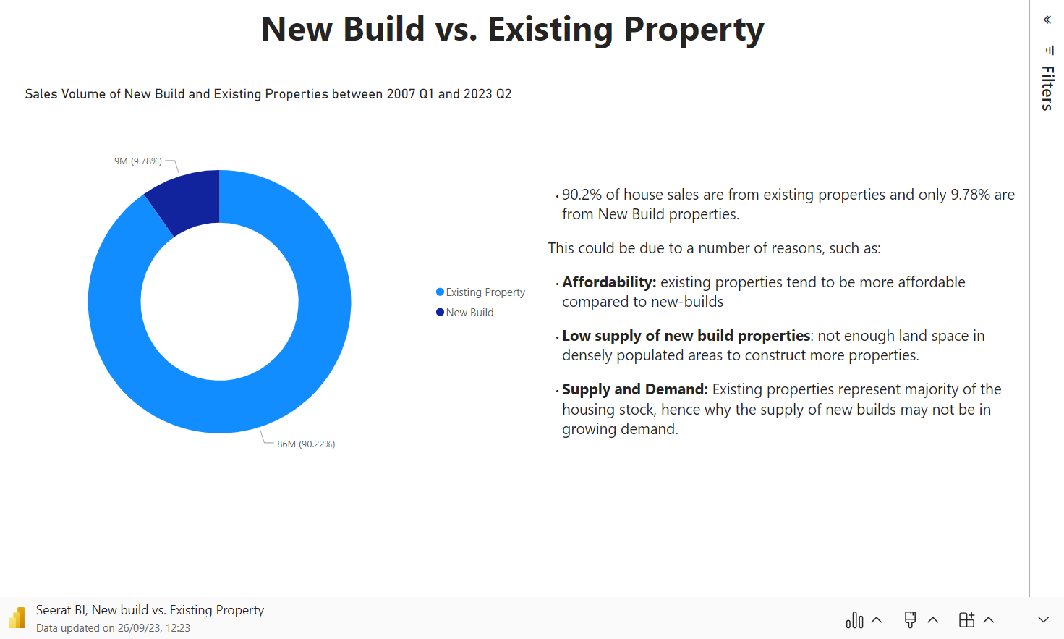

Slide 12

CASH PURCHASES & Mortgages

Slide 13
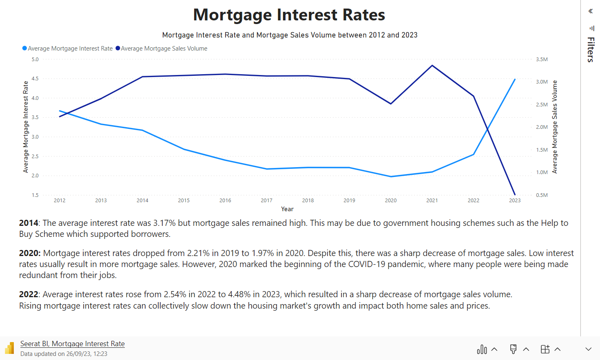

Slide 14
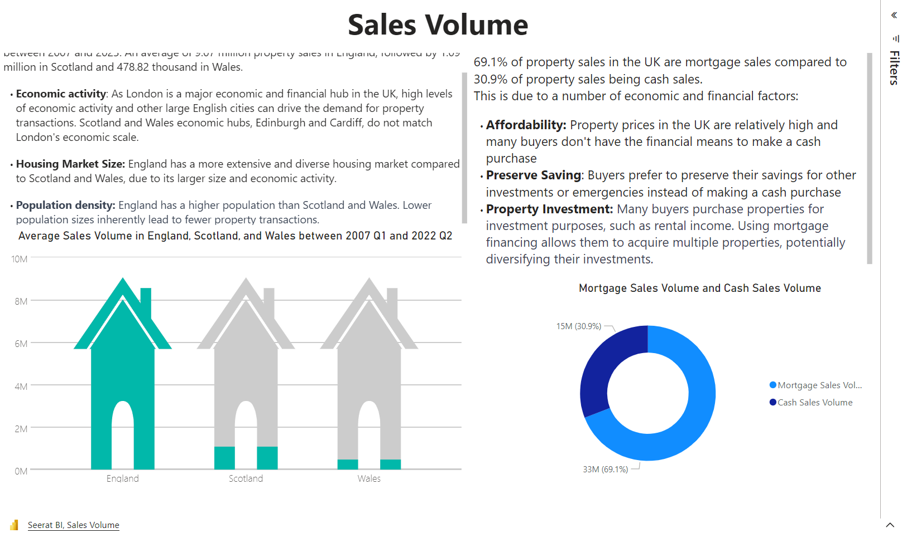

Slide 15
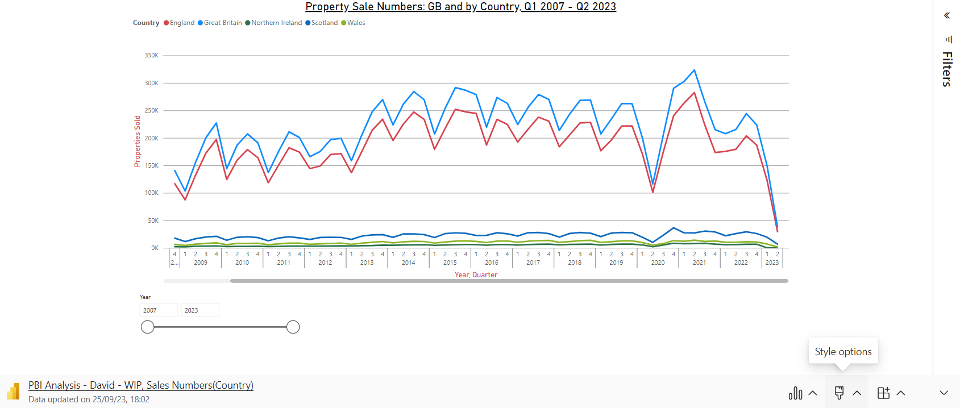
Q3 2007 – Q1 2009: Property sale numbers underwent a sustained and substantial reduction from approx 387,000 per quarter down to 103,000 per quarter. This is likely due to the global financial crisis which led to a lack of confidence in banking and housing by the public.
Q2 2020 – Q2 2021: Sales numbers increased significantly from approx 116,000 to 323,000 per quarter between Q2 2020 and Q2 2021; this is likely due to the availability of record low mortgage interest rates as well as a government introduced stamp duty holiday between 8th July 2020 and 30th June 2021 meaning there was no stamp duty payable on properties worth up to £500k. This is surprising given COVID-19 which introduced restrictions at the time, however viewings were still allowed and the appetite for people to move home (typically to somewhere larger and more remote) was also strong during this time.
Q3 2022 – Current: Sales numbers have reduced substantially from approx 244,000 to 38,000 per quarter. This is likely due to the current economic circumstances which includes much higher CPIH (Consumer Prices Index, including housing costs) inflation and higher mortgage interest rates.

Slide 16
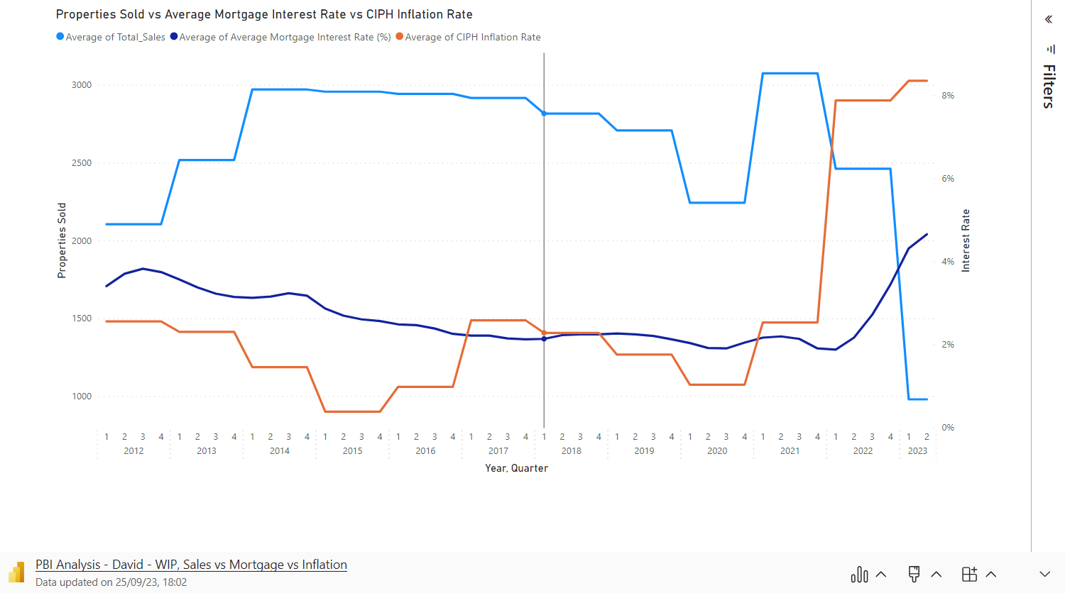

Slide 17
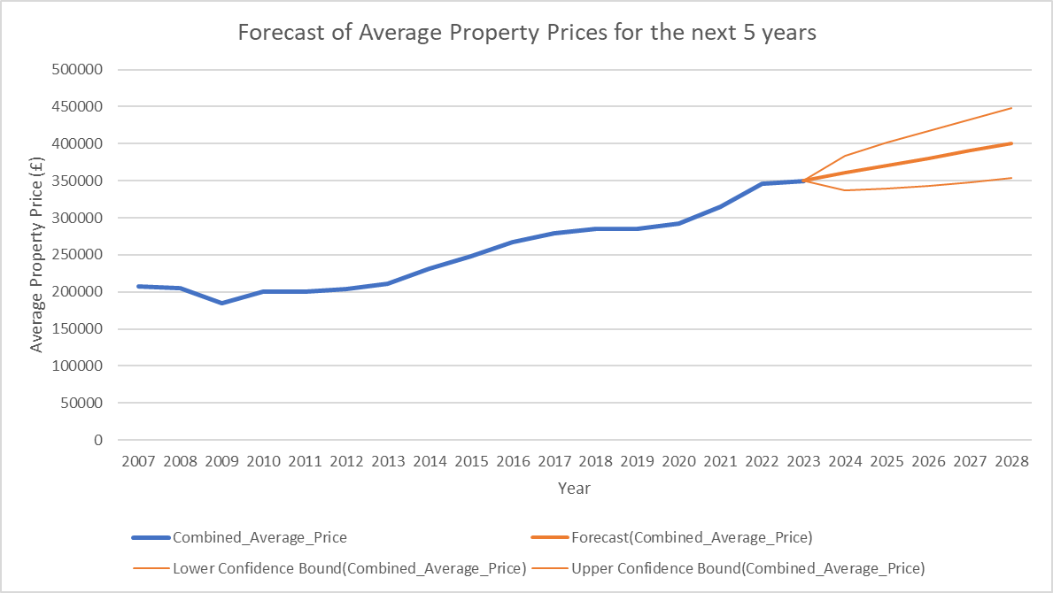
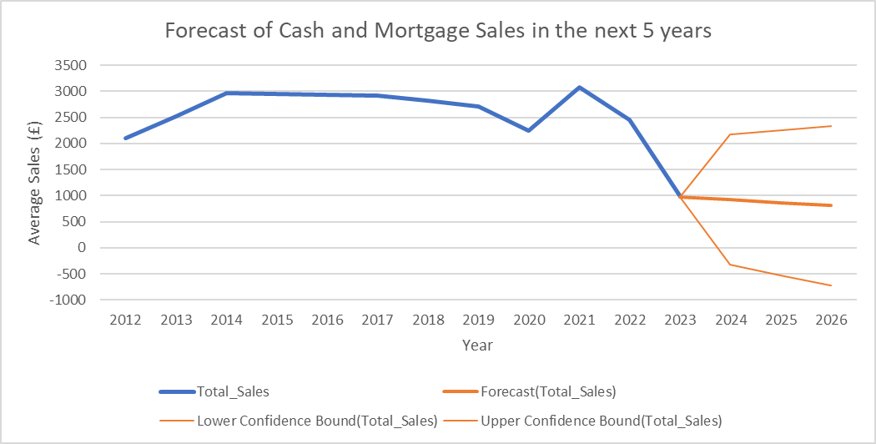
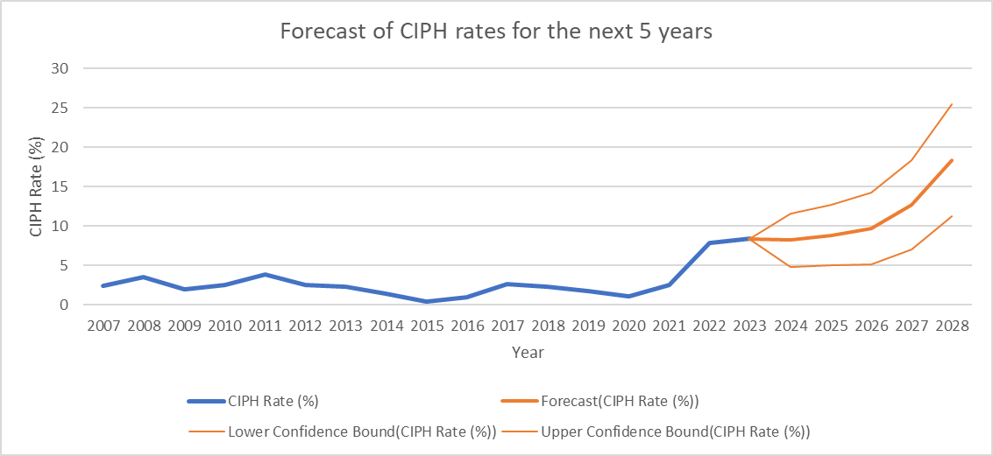
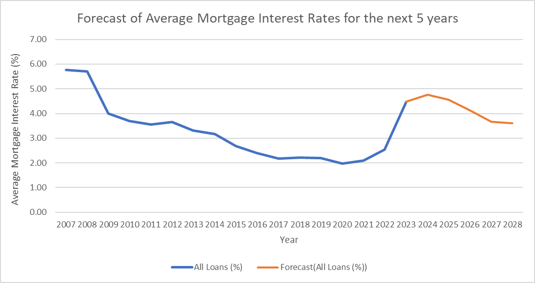
FORECASTS

Slide 18




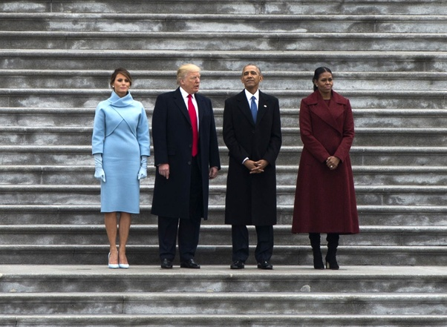



Property Market Timeline
2008
2010
2013
2014
Sept: Stamp Duty was increased to £175,000.
Stamp duty holiday for first-time homebuyers up to £250,000.
April 13: Help to Buy Equity Loan Scheme for England and Scotland.
Jan 14: Help to Buy Mortgage Guarantee Scheme in England.
2016
2018
2020
2021
Dec 16: The Help to Buy ISA scheme
"First Homes" scheme in England
Stamp duty holiday on properties up to £500,000
A new 95% mortgage guarantee scheme.
The Help to Buy Equity Loan scheme in England.

Slide 19
THANK YOU

Slide 20
References
https://www.sanctuary-homes.co.uk/sites/default/files/styles/3_by_2/public/quick_media/the-westcliffs-cgi-resized1.jpg?itok=JgTS-g9u&c=2f757153de64582d29725940d23b3a43 (Images)
https://www.bankofengland.co.uk/boeapps/database/Bank-Rate.asp (Base Rate dataset)
3. https://www.ons.gov.uk/economy/inflationandpriceindices/timeseries/d7g7/mm23 (CPIH dataset)
https://www.gov.uk/government/statistical-data-sets/uk-house-price-index-data-downloads-june-2023 (Average price by property type, Sales, Cash & mortgage sales, New Build and existing resold property datasets)
https://www.bankofengland.co.uk/statistics/mortgage-lenders-and-administrators/2023/2023-q2 (BOE average mortgage rates dataset)

